Slide 1
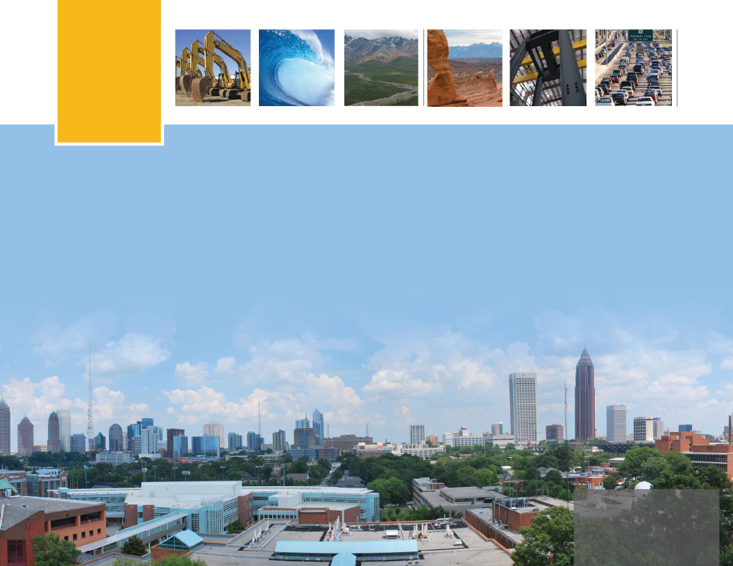
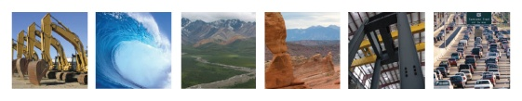

School of Civil and Environmental Engineering
GEORGIA INSTITUTE OF TECHNOLOGY
2011-2012

Slide 2
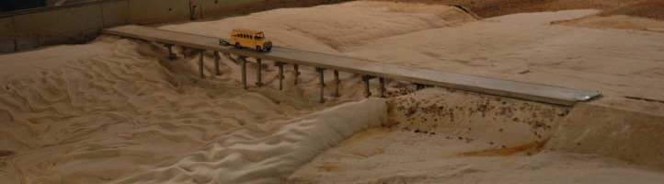
WHAT IS CEE?
Civil and Environmental Engineering (CEE) deals with the design, construction, and maintenance of the physical and naturally built environment. This diverse and dynamic field impacts society by advancing civilization and quality of life.
CEE @ GT
^{OVERVIEW}

Slide 3
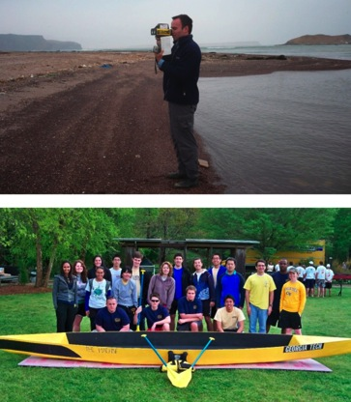
CEE @ GT
Civil and environmental engineers must be creative problem solvers to meet the complex challenges of the 21st Century. CEE’s programs are based on engineering fundamentals and real-world
experience. Students learn how to apply core
engineering principles to multidisciplinary
problems to improve the lives of people on
a global scale.
Undergraduate Degrees:
BS CE
BS EnvE
Our Goal:
Prepare students to excel in engineering careers within a global marketplace
CEE @ GT
^{OVERVIEW}

Slide 4
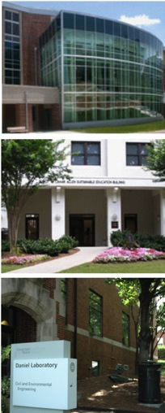
SOME CEE FACTS
+ 2012 U.S. News & World Report undergraduate program rankings
CE 3rd in the nation
EnvE 3rd in the nation
+ Enrollment
879 Undergraduates
360 Graduates
63 Faculty
+ $11 Million in Sponsored Research
+ more than 9,700 Alumni
CEE @ GT
^{OVERVIEW}

Slide 5
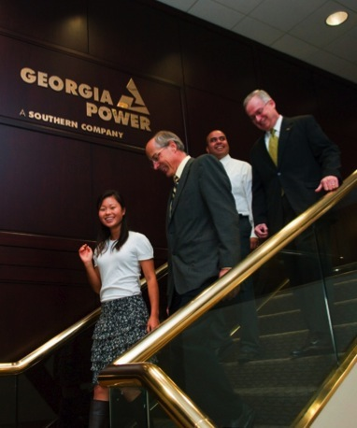
MORE CEE FACTS
Undergrad Stats:
+ Male: 72%
+ Female: 28%
+ 27% of CEE students are in the Co-op program
+ 218 bachelor’s degrees awarded (2010-11)
CEE @ GT
^{OVERVIEW}

Slide 6
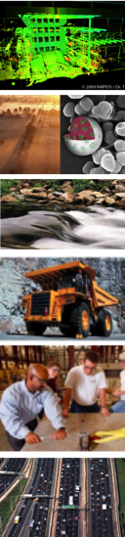
CEE AFFINITY GROUPS
+ Construction
Engineering
+ Environmental
Engineering
+ Environmental Fluid
Mechanics and Water Resources
+ Geosystems Engineering
+ Structural Engineering,
Mechanics and Materials
+ Transportation Systems
Engineering
CEE @ GT
^{RESEARCH}

Slide 7
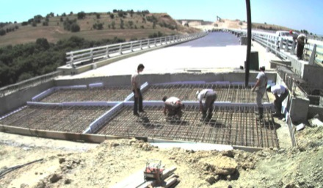
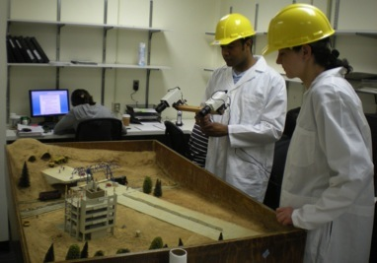
CONSTRUCTION ENGINEERING
Construction Engineering employs projects in:
construction information technology
infrastructure sensors and sensor systems
construction data modeling and visualization
knowledge management for decision support systems and other advanced technology-based areas.
CEE @ GT
^{CONSTRUCTION}

Slide 8
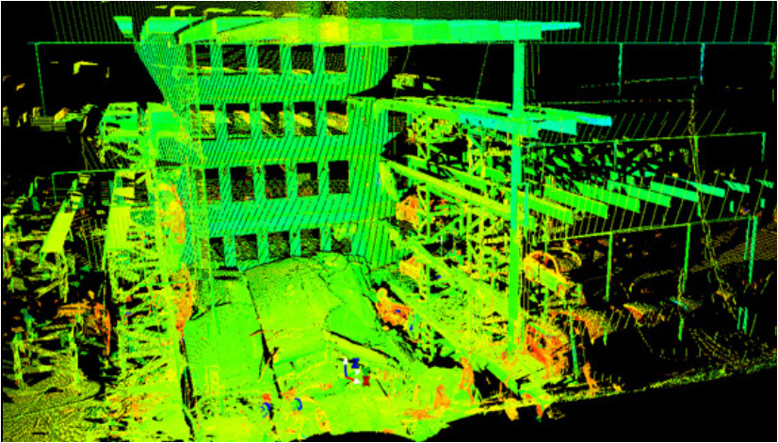
CONSTRUCTION ENGINEERING
Dr. Teizer: sensor monitoring of safety personnel evaluating a collapsed
parking deck.
CEE @ GT
^{CONSTRUCTION}

Slide 9

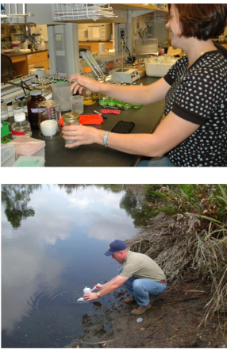
ENVIRONMENTAL ENGINEERING
Using science & engineering principles for remediation and improvement of air, water, and land resources
Environmental biotechnology
Water quality and treatment
Wastewater reclamation and reuse
Hazardous and solid waste engineering
Ground water modeling and treatment
Air quality monitoring, pollution control and modeling
Environmental sciences
Industrial ecology
CEE @ GT
^{ENVE}

Slide 10
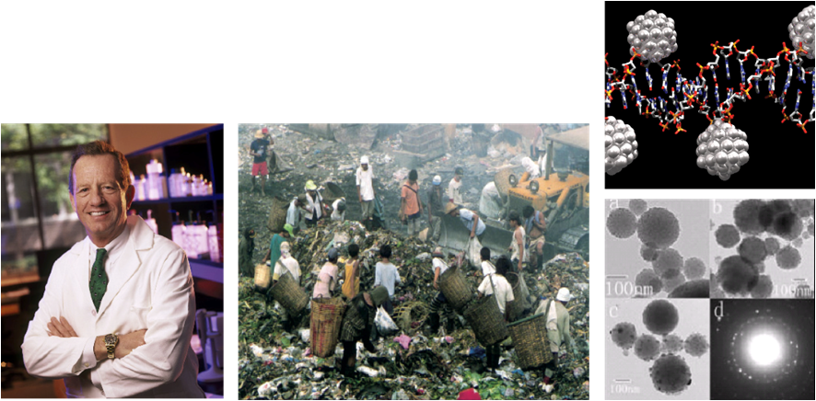
ENVIRONMENTAL ENGINEERING
Global Water and Sanitation:
. 4 billion suffer chronic water borne disease
. 2.3 billion lack any sanitary facilities
. 1.3 million children die each year from diarrhea
Dr. Crittenden The application of Granular Activated Carbon (GAC) to remove toxic organics from air and water, and the use of air stripping towers to remove volatile organic chemicals (VOCs).
CEE @ GT
^{ENVE}

Slide 11
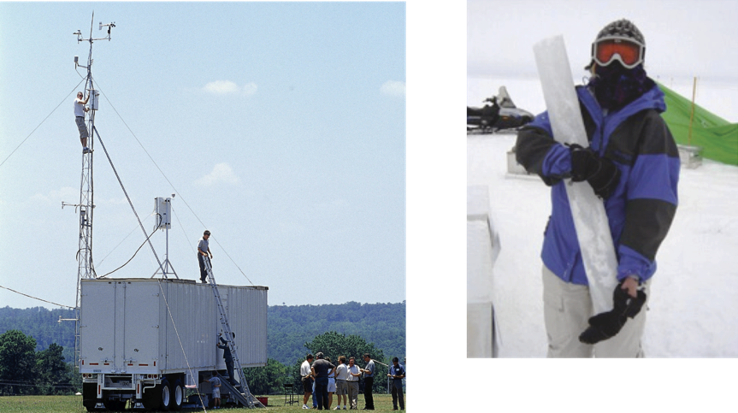
ENVIRONMENTAL ENGINEERING
Dr. Russell Tropospheric ozone formation and measurement
Environmental sampling in the Arctic Circle.
CEE @ GT
^{ENVE}

Slide 12
ENVIRONMENTAL ENGINEERING
Dr. Kim (Left) Students testing new nanomaterials designed to inactivate pathogenic microorganisms in water
(Above) EnvE student cultivating bacteria in chemostat vessels.
CEE @ GT
^{EnvE}

Slide 13
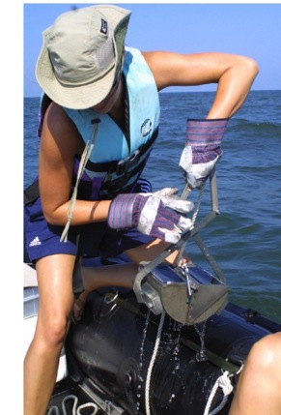
ENVIRONMENTAL FLUID MECHANICS & WATER RESOURCES
Water, Air & Land Systems:
. Science & engineering applications
of environmental transport processes
. Sustainable resource management
. Innovative experimental, computational, and modeling research
. State of the art technologies to benefit engineering practice in fluid mechanics, hydraulics, hydrology, hydroclimatology, and water resources.
CEE @ GT
^{EFM&WR}

Slide 14
ENVIRONMENTAL FLUID MECHANICS & WATER RESOURCES
Dr. Georgakakos
Decision Support System
Dr. Roberts
Boston Harbor Wastewater Project
CEE @ GT
^{EFM&WR}

Slide 15
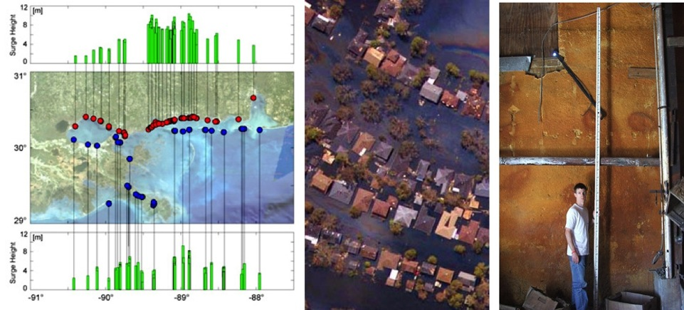
ENVIRONMENTAL FLUID MECHANICS & WATER RESOURCES
Dr. Fritz Hurricane Katrina Reconnaissance
CEE @ GT
^{EFM&WR}

Slide 16
ENVIRONMENTAL FLUID MECHANICS & WATER RESOURCES
Dr. Haas Rip Current Investigation Using Dye
CEE @ GT
^{EFM&WR}

Slide 17
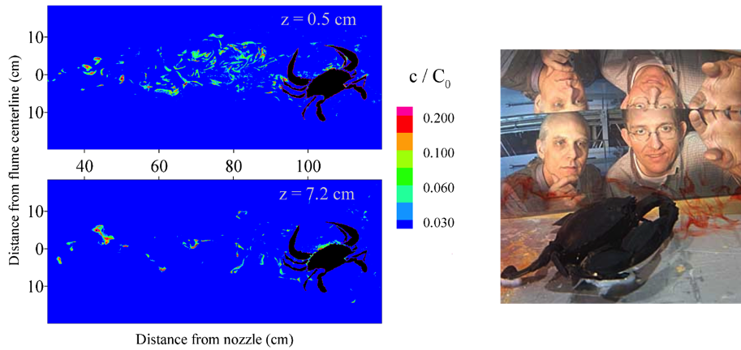
ENVIRONMENTAL FLUID MECHANICS & WATER RESOURCES
Dr. Webster Hydrodynamics of Chemical Sensing Among Organisms
CEE @ GT
^{EFM&WR}

Slide 18
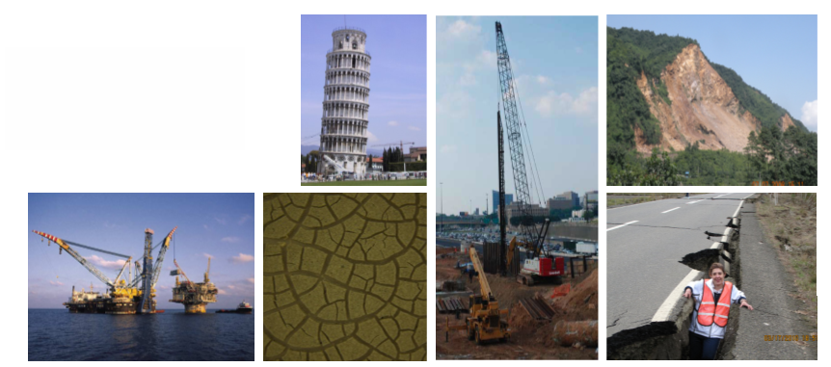
GEOSYSTEMS ENGINEERING
+ Geotechnical (Soils Mechanics)
+ Geomechanics (Rock Engineering)
+ Geoenvironmental (Bio & Chem)
Dams & Reservoirs
Tunnels
Slope Stability
CEE @ GT
^{GEO}

Slide 19
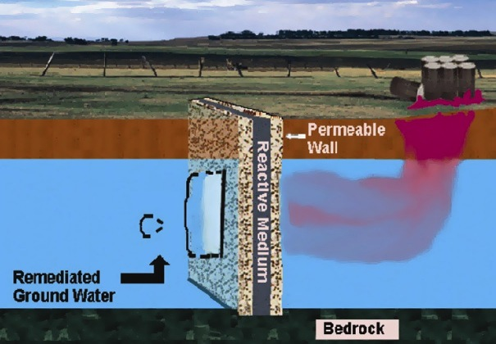
GEOSYSTEMS ENGINEERING
Passive Flow Reactive Barrier
CEE @ GT
^{GEO}

Slide 20
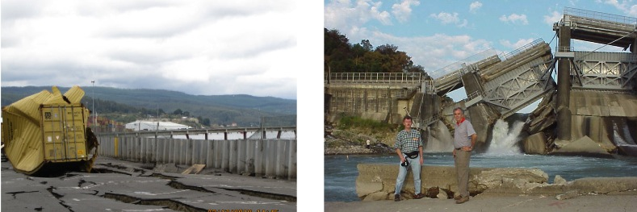
GEOSYSTEMS ENGINEERING
+ Earthquake Engineering
+ Liquefaction Evaluation
+ Ground Amplification
Chile, 2010
Chi-Chi, Taiwan, 1999
CEE @ GT
^{GEO}

Slide 21
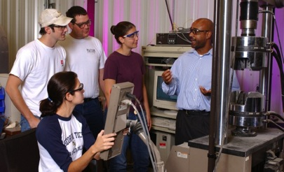
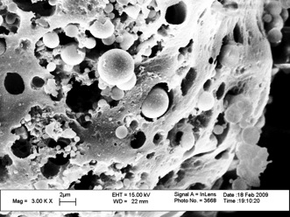
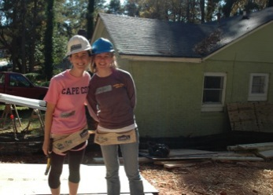
STRUCTURAL ENGINEERING
+ Bridge Design
+ Building Design
+ Loading Evaluations
+ Concrete and Steel Design
+ Earthquake Engineering
+ High Performance Materials Testing
CEE @ GT
^{SEMM}

Slide 22

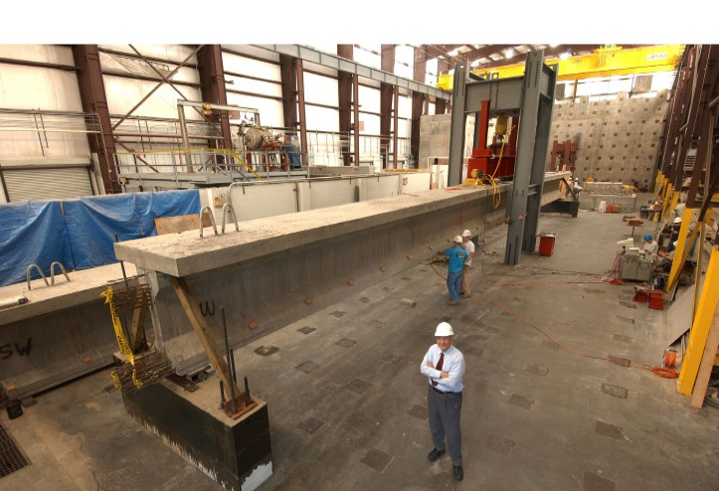
STRUCTURAL ENGINEERING
Dr. Kahn High-strength Concrete Pre-stressed Beam
CEE @ GT
^{SEMM}

Slide 23
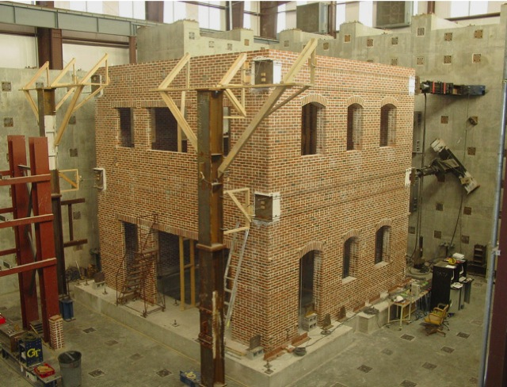
STRUCTURAL ENGINEERING
Dr. Leon Masonry building tested in Structures Lab
CEE @ GT
^{SEMM}

Slide 24
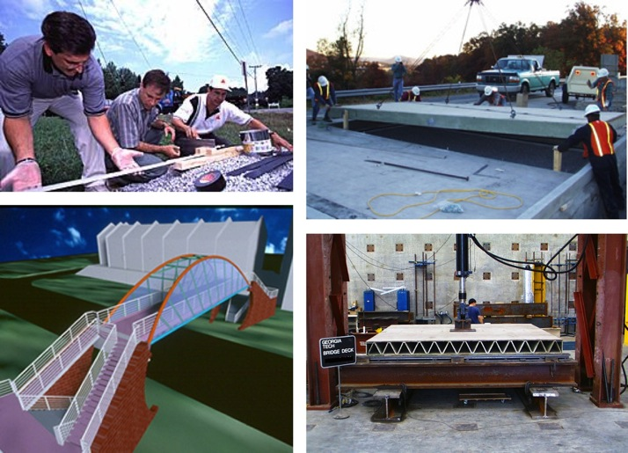
STRUCTURAL ENGINEERING
Dr. Zureick FRP (Fiber Reinforced Polymer) Bridge Testing
CEE @ GT
^{SEMM}

Slide 25
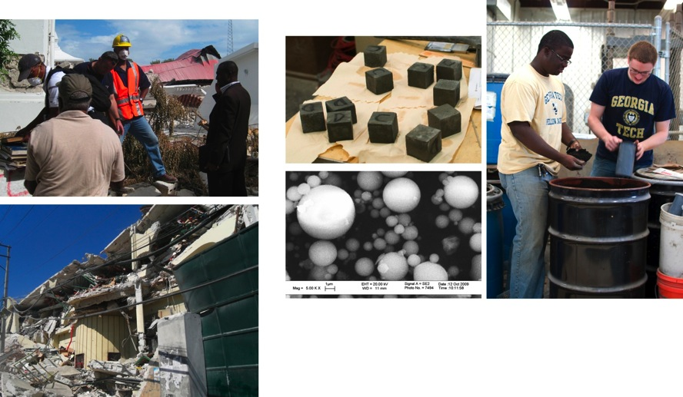
STRUCTURAL ENGINEERING
Dr. DesRoches Structural assessment of earthquake damage in Haiti
Drs. Burns and Kurtis Engineering new, high-strength materials using varying concentrations of by-products of bio-fuel energy generation
CEE @ GT
^{SEMM}

Slide 26
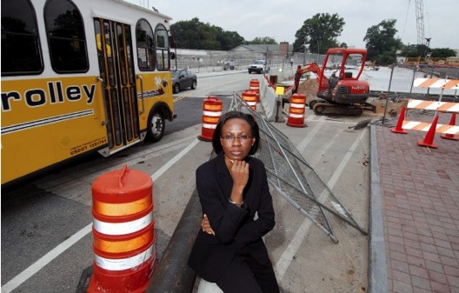
TRANSPORTATION SYSTEMS ENGINEERING
+ Multimodal Transportation Studies
+ Design of Transportation Facilities and Networks (e.g. airports, highways and transit systems)
+ Traffic Control and Operations
+ Transportation Safety
+ Transportation Administration,
Planning and Policy
CEE @ GT
^{TSE}

Slide 27

TRANSPORTATION SYSTEMS ENGINEERING
‘MEGACITIES WILL POSE HUMANITY’S GREATEST CHALLENGES FOR THE NEXT CENTURY’
-National Research Council
CEE @ GT
^{TSE}

Slide 28
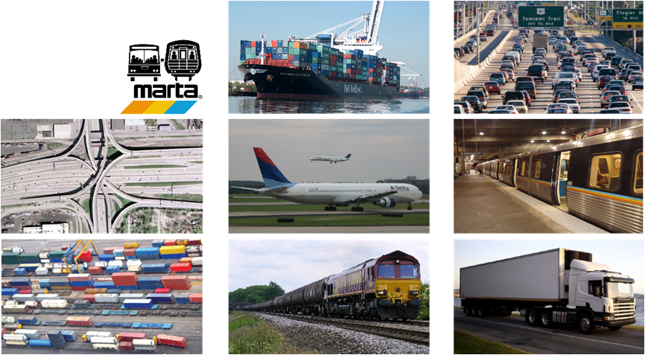
TRANSPORTATION SYSTEMS ENGINEERING
+ System productivity for all modes of passenger travel and freight
+ Economic growth
+ Finance
CEE @ GT
^{TSE}

Slide 29
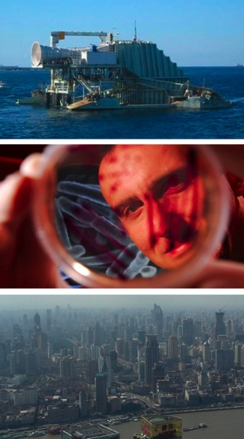
RESEARCHING THE FUTURE
. Energy - exploring issues relevant to supplying energy to meet the needs of growing populations in this and future generations.
. Materials - as urban populations burgeon, advances in materials and technology will be critical to support and improved quality of life in developed and developing economies.
. Health - human well-being and progress toward sustainable development are vitally dependent upon improving the management of human living environments to ensure conservation and sustainable use.
. Megacities - rapid urbanization has contributed to the world’s air pollution and water restraints.
CEE @ GT

Slide 30

UPON GRADUATION
Types of Jobs for CEEs:
+ Private consulting firms involved with aspects of planning, design, construction, or sustainability
+ Development of facilities, resources, and environmental controls for industrial development
+ Municipal, state, or federal agencies
+ Owning his/her own business
+ Design work
Additional Opportunities:
+ Professional Engineering (PE) license
+ Graduate school

Slide 31
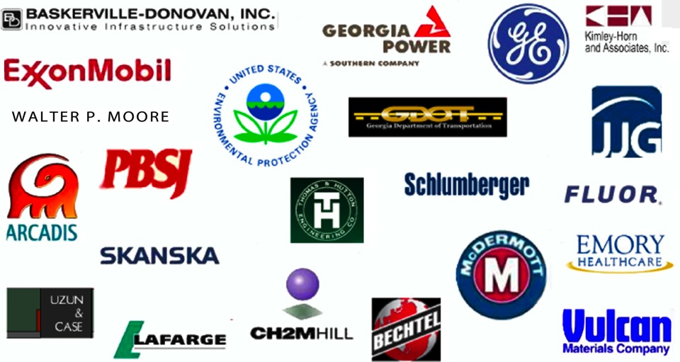
WHERE CEE ALUMNI WORK

Slide 32
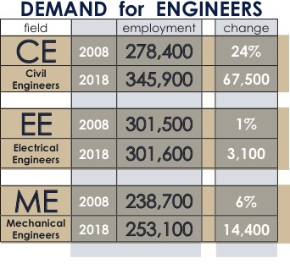
…and BEYOND
The need for civil and environmental engineers will continue to increase in future decades due to:
. GLOBALIZATION
. POPULATION DYNAMICS
. ENVIRONMENTAL CONCERNS
. TECHNILOGICAL REVOLUTION
. URBAN DEVELOPMENT
U.S. Department of Labor, Bureau of Labor Statistics.
^{(NOTE: Projected Employment)}

Slide 33

QUESTIONS?
CEE @ GT

